Slide 1
Community expansion in social networks
Yuanjun Bi
Jan. 13, 2013

Slide 2
Problem Motivation
Problem Formulation
Models
Adopter Model
Benefit Model
Combine Model
Algorithm
Experiments
Conclusion

Slide 3
Problem Motivation
Community itself?
Online communities in people’s life
share information
get benefit

Slide 4
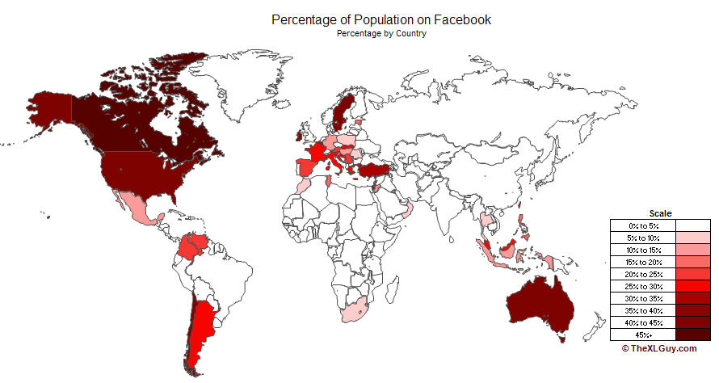
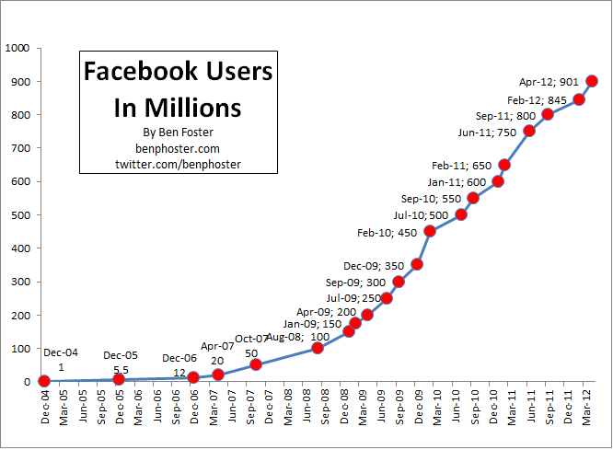
Problem Motivation
Communities need to be expended!
For the organizers of communities, enlarge the size of community can bring more benefit and improve the fame of community.

Slide 5
Application 1
Broaden Sales Horizons
How to find potential customers.
Analyzes how existing customers organized
Provide strategies
http://xiaogangzhu.blogspot.com/2012/04/small-business-trends-in-2012.html

Slide 6
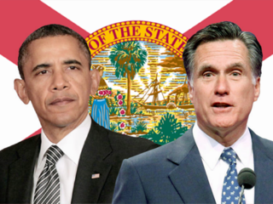
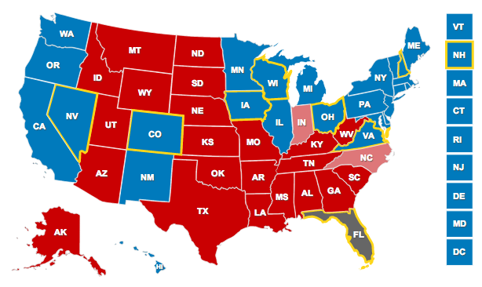
Application 2
1
Political Campaign
Spread influence towards decision making process
Offering insight in choices during campaign activities
2
1: http://www.abcactionnews.com/dpp/news/region_tampa/superstorm-freezes-political-campaigning
2: http://www.politicspa.com/election-results-morning-buzz/44128/

Slide 7
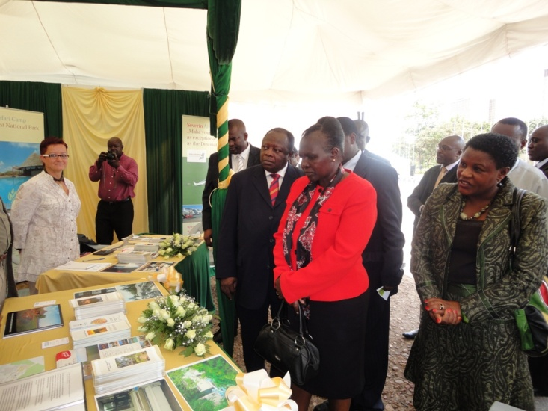
Application 3
1
Boost Exhibition Participation
Choosing excellent exhibit display participators
Larger size and higher level
Budgetary requirement
1: http://www.environment.go.ke/image-gallery/april-2011/images-of-go-green-expo-at-kicc-eco-village-discussions-april-2011

Slide 8
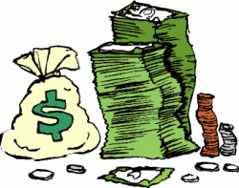
Problem Illustration
To attract new members
Arrangements in promotional
activities– Salesmen, Cost
Key problem: Who should be
the valuable potential customer to be served the promotional activity

Slide 9
Definition

Slide 11
Definition
New Comers (MC and AC)
Mark Customer(MC)
new members who received promotion
Automatical Customer(AC)
new members who didn’t receive any promotion
join in TC for friends’ recommendation

Slide 12
Problem Formulation
Influence from community
Influence to neighbors through “word of mouth”
Final influence from target Community to one individual i

Slide 13
Community Expansion problem
Given social network G(V, E, W), sales list SL, target community TC and time slot
find nodes sets L_{t} , such that the influence from TC to L_{t}
customers that receive promotion and join in TC(MC)
customers attract their neighbor(AC)

Slide 14
Assumptions
Specific potential client each time
Do promotion to only one customer in SL each time.
One customer can receive promotion once and only once.
Closed customers information open community information
Sale Lists aren’t overlapping
Everyone knows the latest Target Community structure
No new connection details
Don’t care about new connections of the new members
Large social network, small time slot, salesmen

Slide 15
Comparison with Influence Maximization problem
Community expansion problem | Influence maximization problem
Interfering during the whole expansion progress | Only once interfering at the start of infusion progress
Goal is to enlarge the target community based on community structure | Goal is to enlarge the influence from the initial seed set

Slide 16
Models
Observation 1
The probability p of joining one community depends k friends in the community.
The relation between p and k are under the “ law of diminishing returns”. i.e. additional k has little impact on p
The connection density of k friends effect p
If there are no friends in the Target Community, “how far” from the Target Community infers “how much” influence got from TC

Slide 17
Models
Observation 2
celebrities has positive impact on consumer attitudes towards the brand and purchase intention
In the real world the celebrities are more likely be known by others
In the social network graph, nodes with more neighbors can be seen as “celebrities”, which can effect more customers

Slide 18
Adopter Model
η denotes the value of how easy an individual adopts the promotion from TC.
a₁ a₂ a₃ a₄ are adjusted parameters
k is the number of friends in TC
n is the number of neighbors

Slide 19
Adopter Model
p is not linearly increase with k
k/n: when node A and node B both have 4 friends in TC, but A has 100 neighbors while B has 7 neighbors
ρ is the number of pairs among k friends
is the total pairs if any two nodes in k friends have a connection

Slide 20
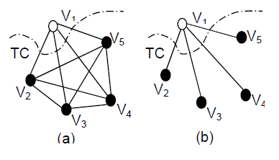
Adopter Model
In fig.a
$d_{in}$= 1
In fig.b
$d_{in}$= 0

Slide 21
Benefit Model
θ denotes the benefit that an individual can bring into TC. This model is important when the marketing strategy considers the cost constraints.
b₁ b₂ b₃ are adjusted parameters.
k/n presents the tendency of how many potential customers that the individual can attract.

Slide 22
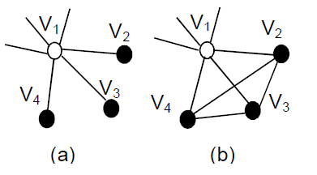
Benefit Model
d_{out} denotes the connections density among friends who are not in TC
In Fig (a), the connections between these three friends is 0 while in Fig (b), the three friends have connections with each other so they are not that easily persuaded by V₁.

Slide 23
Combine model
Finding a balance between Adopter Model and Benefit Model.
Choosing customers who are not too easily joining TC but still have some benefit to attract new customers.
c₁ c₂ c₃ c₄ are adjusted parameters.
din and dout are the same definition as before.

Slide 24
Algorithm(ETC)
Given TC,SL, all nodes’ properties in SL
Compute all nodes’ score and sort each SL
Form Mark Customer set (MC)
Update graph structure
Form Automatically Customer set(AC)
New customer = MC + AC

Slide 25
Compute Score
Adopter
(ETCA)
Benefit
(ETCB)
Combine
(ETCC)

Slide 26
Finding Mark Customer set(MC)
Choose the first node from each sales list
Each node become mark customer with some probability

Slide 27
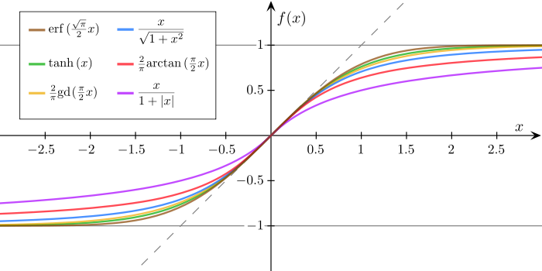
Sigmoid function

Slide 28
Update graph structure
TC
a
b
k
k/n

Slide 29
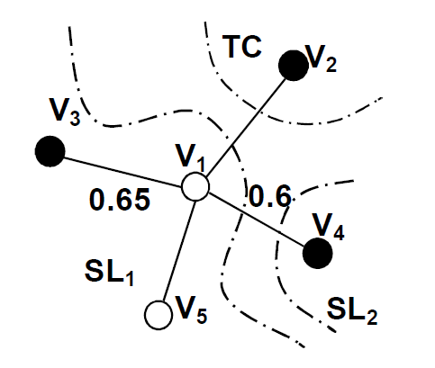
Automatically Customer
V₁ .k = 1+0.65+0.6 = 2.25
V₁ . n = 4
2.25 / 4 > λ(0.5), so V₁ will come!

Slide 30
Experiment
Data Sets
NetHEPT
Authors and co-authorship in “High Energy Physics(Theory) from 1991 to 2003”
Arenas/emails
Members in Univ. of Rovira i Virgili, Tarragona. and their connection via emails
American College Football (ACF)
Team and their regular-season games
FaceBook
Users and their friendship

Slide 31
Data sets properties

Slide 32
Compared algorithm
ETC: ETCA, ETCB, ETCC
RANDOM
TABI:
a heuristic algorithm proposed by Tao, et al to solve the participation maximization problem. It only considers people who have participated in the forum.

Slide 33
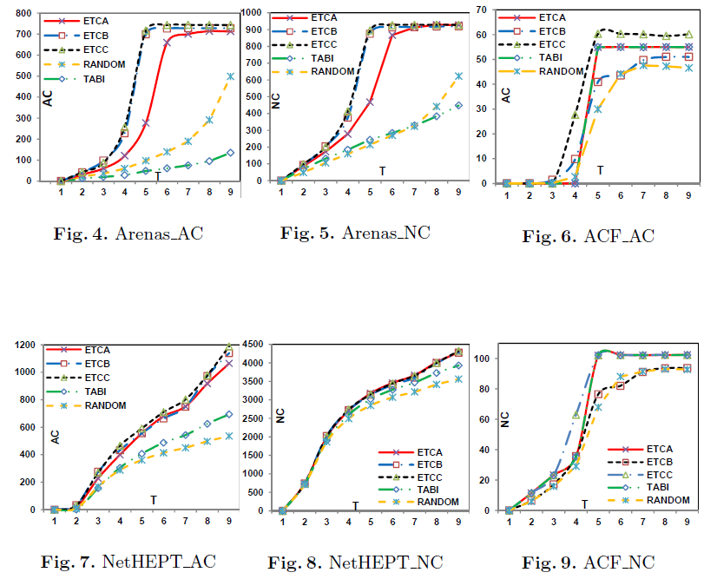
Results

Slide 34
Results
Fackbook data set has the small average degree of each node, which means the distribution of nodes is scattered. There are more nodes are easy to persuaded into TC. So ETCA performs better.
TABI only considers nodes who have connections in TC while the ratio of close friends in the dataset is rather small.
ETCC keep high value in larger range of λ

Slide 35
Conclusion
Problem definition: community expansion
Three models: Adopter, Benefit, Combine
Heuristic Algorithm: ETC
Experiments:
ETC performs better than TABI, RANDOM on attracting new members.
ETC has the high efficiency.
ETC stay stable with parameter λ

Slide 36
Thank you!

